Slide 1

Game Development
By Patryk Pawlicki

Slide 2
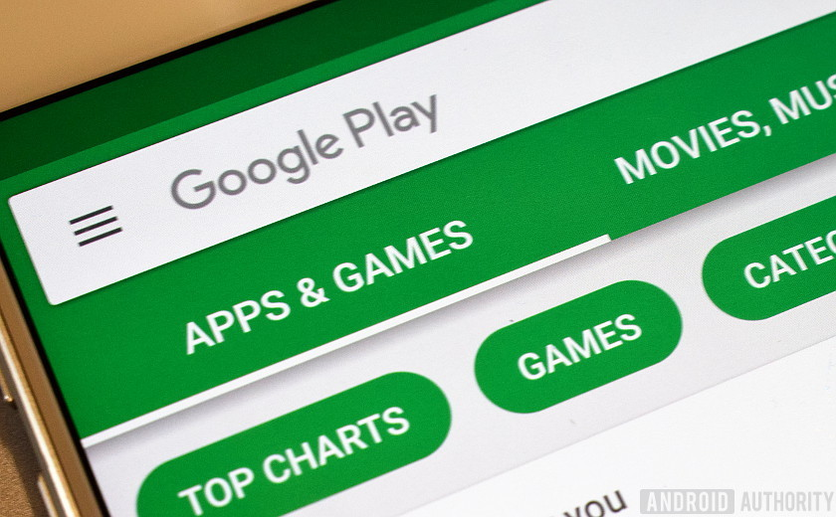
Project Aim
Create a simple Game for Android mobile devices using Android SDK
Object oriented design
Game will include a functional GUI
Available on Android Store

Slide 3

My progress so far
Series of Reports and Research
Android Life Cycle
Design Patterns
Animation Techniques
Worker Threads in a GUI
Design of a GUI based mobile game
XML for GUIs
Proof of concept programs
Hello World
Explosion Animation
XML based UI

Slide 4

Game Concept
Game called “Balloons”
Objective
Pop balloons
Collect coins
Buy upgrades
Compete with other players
Game ends when player is out of “lives” (runs out of missed balloons allowance)

Slide 5
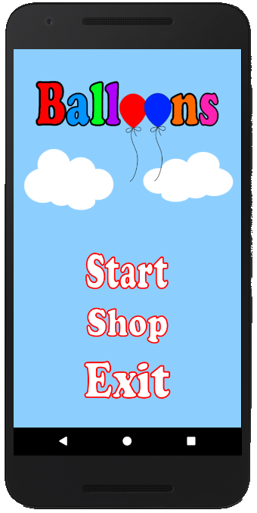
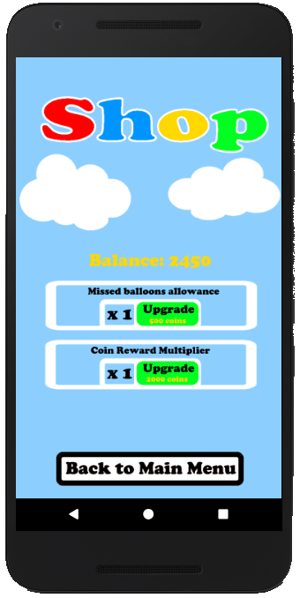
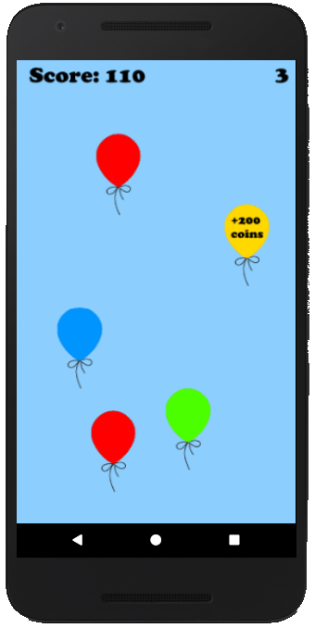
Game Design
Main Menu
Shop UI
Gameplay

Slide 6

Future plans
Develop the game
Fully functional animated gameplay
Splash screen and at least 2 user interaction screens
Available on the Android Store
Research and Construct Reports
Documenting the development
Description of the Android Framework
Threads, Workers, Battery Life
Special considerations for mobile applications
Techniques and data structures used

Slide 7

Possible extensions
Add a High scores system
More upgrade options
Visual upgrades / customisability

Slide 8

Any questions?

